Slide 1
Lagrange Duality
Dual function, strong duality, and sensitivity analysis
Student: Amila Snagic 20098
Professor: Izudin Dzafic
Faculty of Electrical Engineering Sarajevo

Slide 2
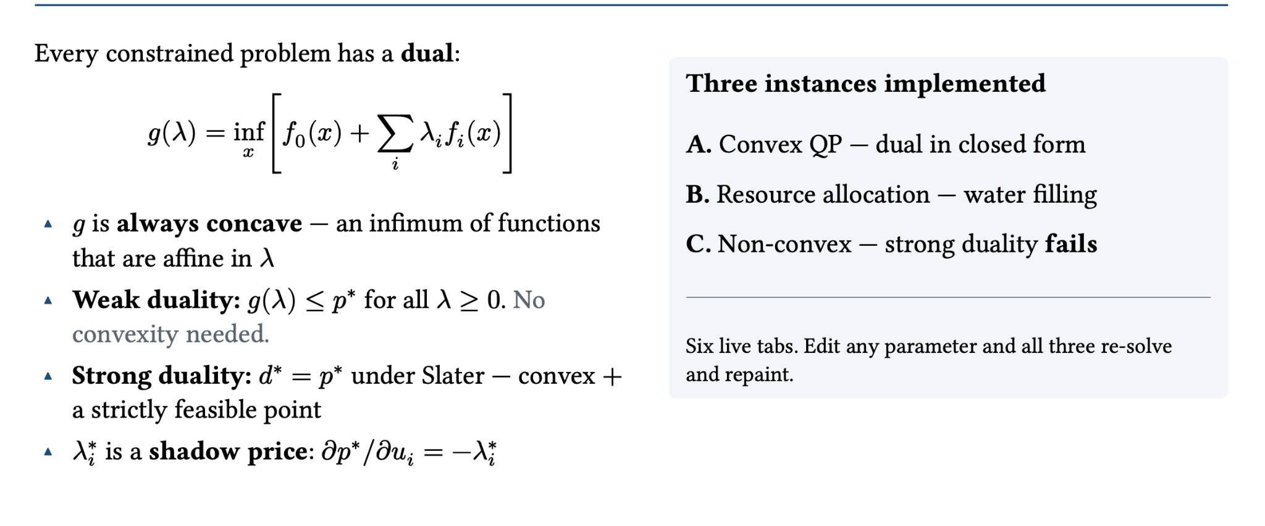
The main idea

Slide 3
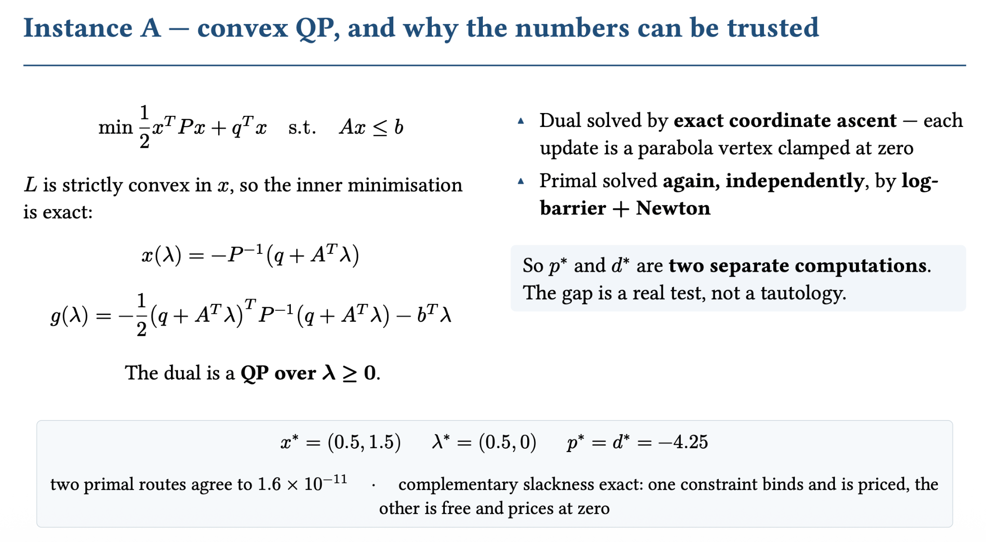

Slide 4
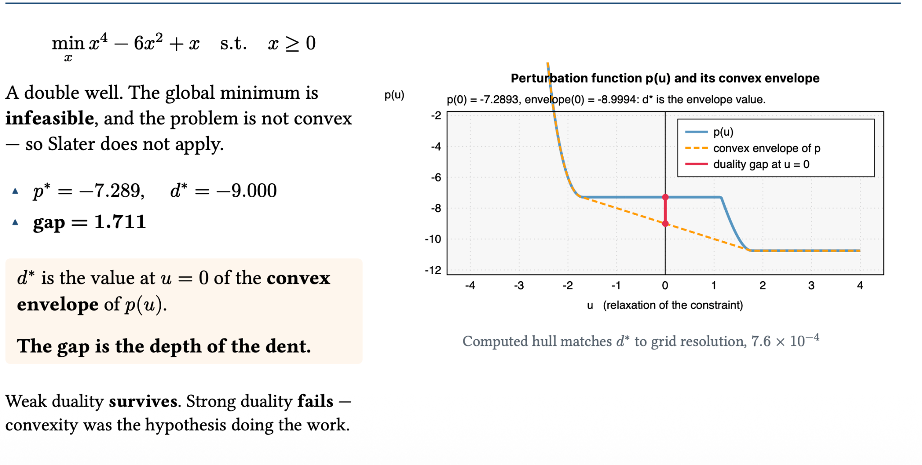
The duality gap

Slide 5
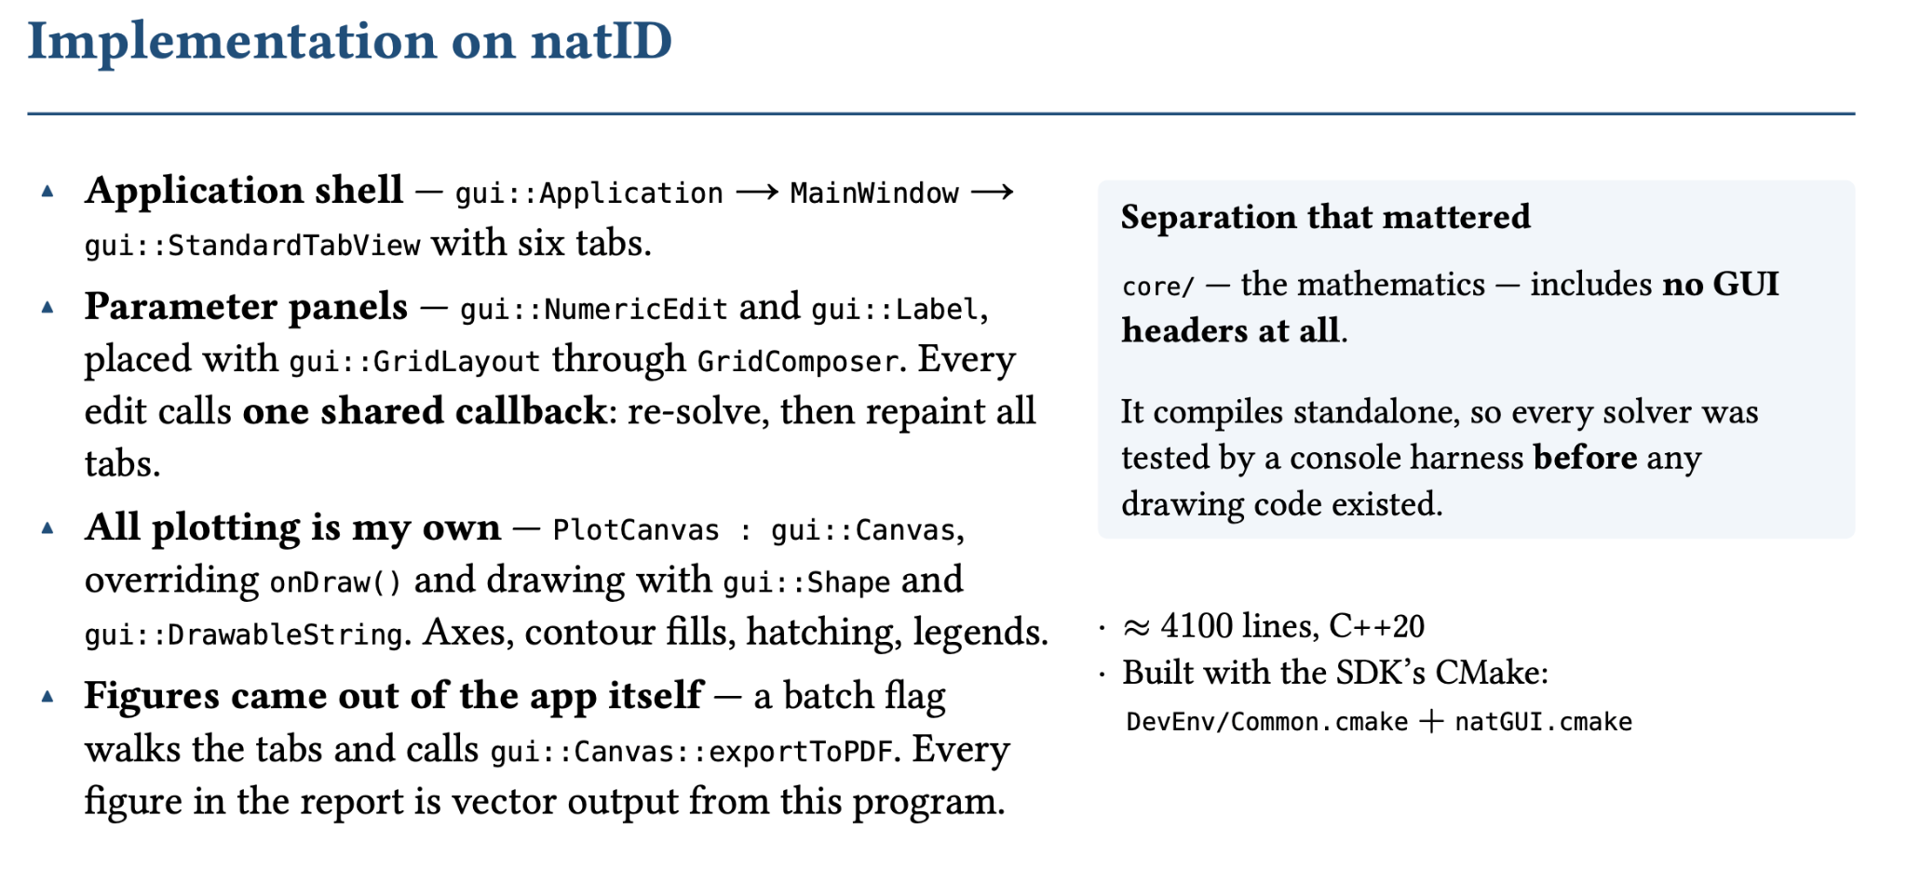

Slide 6
